Slide 1

Web Applications

Slide 2
The Three Major Types of Web Applications
Static website
Dynamic website
Single Page Application

Slide 3
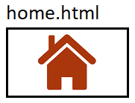







Client
Static Website
Server

Slide 4
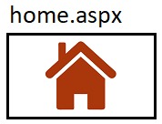

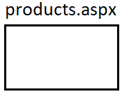


Client
Dynamic Website
Server

Slide 5
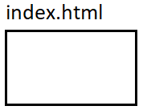





Client
Single Page Application
Server
Service
{ JSON }

